Slide 1
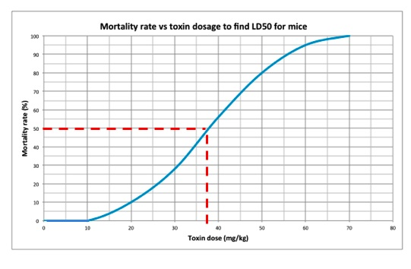
LD50 Data Table Toxin Used: _____
Concentration of Toxin | Number 0f Seeds | Number Germinating | Number Non Germinating | Percent Mortality
Graph –
X axis – Toxin Dose (units)
Y axis – Percent Mortality%

