Slide 1
Island Biogeography
Simulation Activity

Slide 2
Simulation
Go the following website:
http://virtualbiologylab.org/ModelsHTML5/IslandBiogeography/IslandBiogeography.html?fbclid=IwAR2GF5XKUjsu0CgVzvPx4mQsVDFAkwA6tpd4mGWN29k98zl1snp0IAf7R3w
You can go read through the background information and tutorial if you wish.
Click on “Run Experiments” to complete the activity

Slide 3
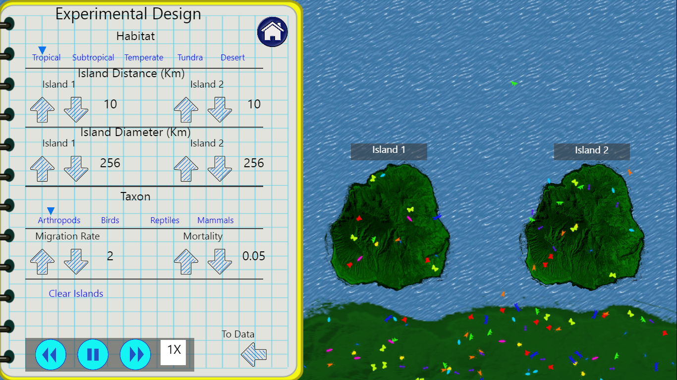
Settings for
Simulation #1

Slide 4
Question #1
Use the settings from the previous slide.
Click on the “data” arrow.
Run the simulation for 300 seconds
Answer the question:
After 300 seconds, what is the average number of species for each island?

Slide 5
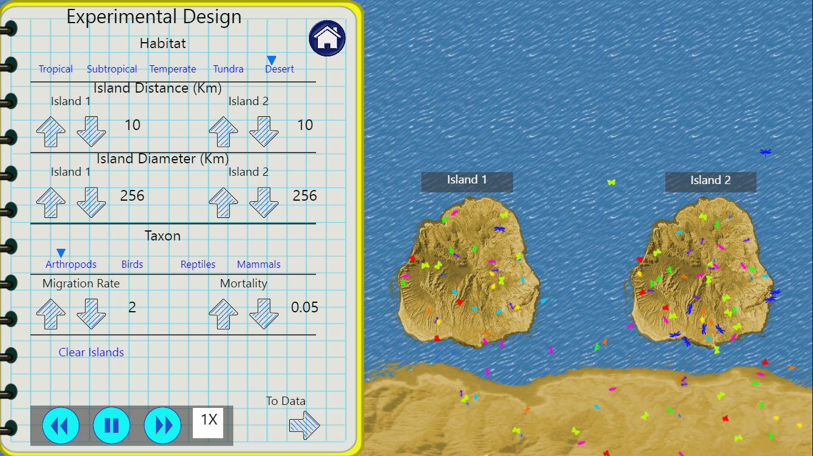
Settings for
Simulation #2

Slide 6
Question #2
Use the settings from the previous slide.
Click on the “data” arrow.
Run the simulation for 300 seconds
Answer the questions:
After 300 seconds, what is the average number of species for each island?
Explain the differences in averages between simulation #1 and simulation #2.

Slide 7
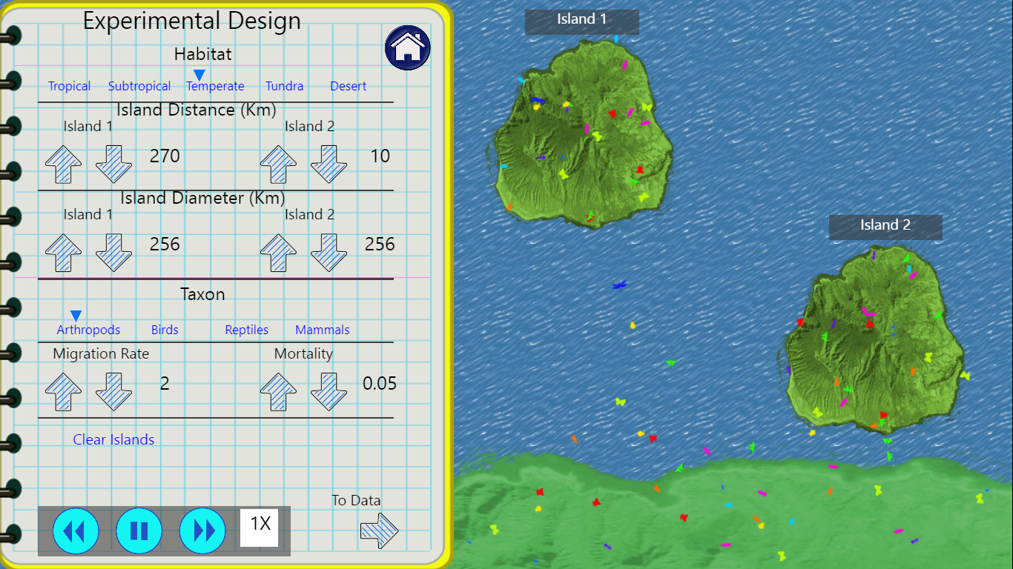
Settings for
Simulation #3

Slide 8
Question #3
Use the settings from the previous slide.
Click on the “data” arrow.
Run the simulation for 300 seconds
Answer the questions:
After 300 seconds, what is the average number of species for each island?
Explain the differences in averages between the two islands.

Slide 9
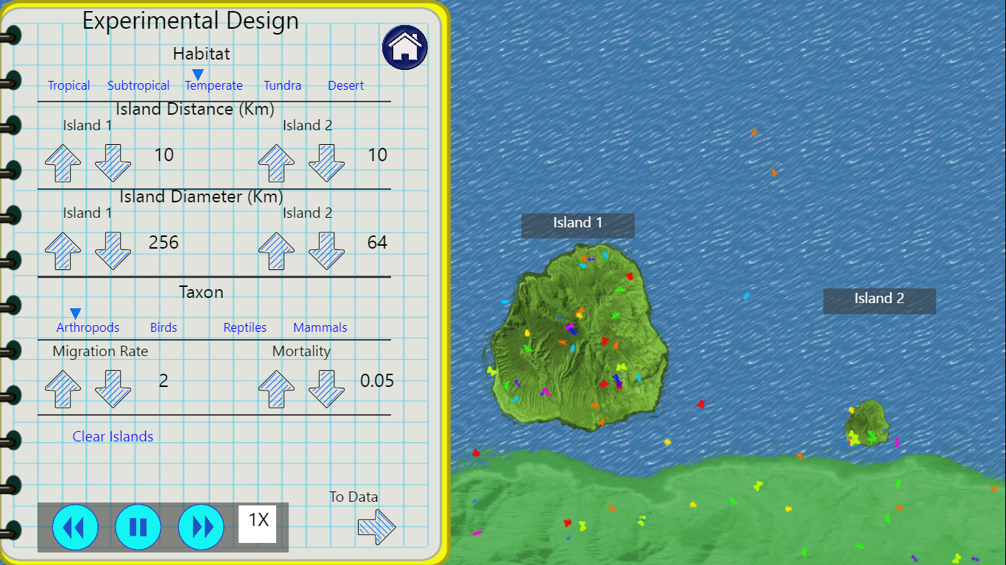
Settings for
Simulation #4

Slide 10
Question #4
Use the settings from the previous slide.
Click on the “data” arrow.
Run the simulation for 300 seconds
Answer the questions:
After 300 seconds, what is the average number of species for each island?
Explain the differences in averages between the two islands.

Slide 11
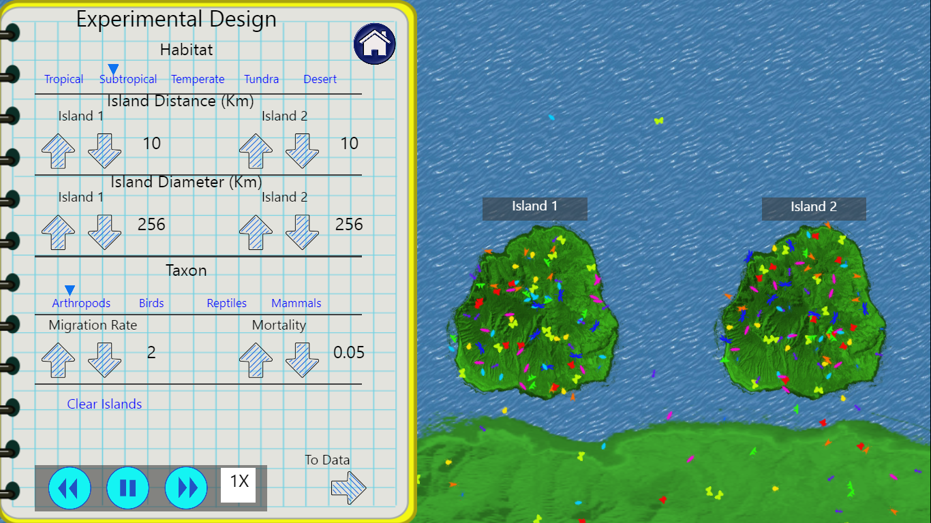
Settings for
Simulation #5

Slide 12
Question #5
Use the settings from the previous slide.
Click on the “data” arrow.
Run the simulation for 300 seconds
Answer the questions:
After 300 seconds, what is the average number of species for each island?

Slide 13
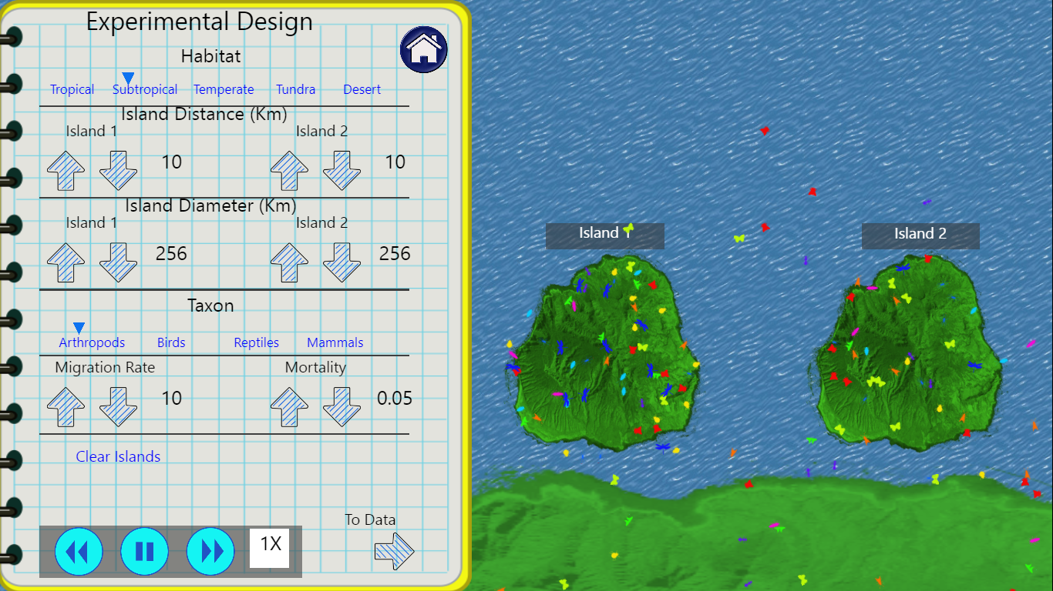
Settings for
Simulation #6

Slide 14
Question #6
Use the settings from the previous slide.
Click on the “data” arrow.
Run the simulation for 300 seconds
Answer the questions:
After 300 seconds, what is the average number of species for each island?
Explain the differences in averages between the islands in simulation #5 and simulation #6.

Slide 15
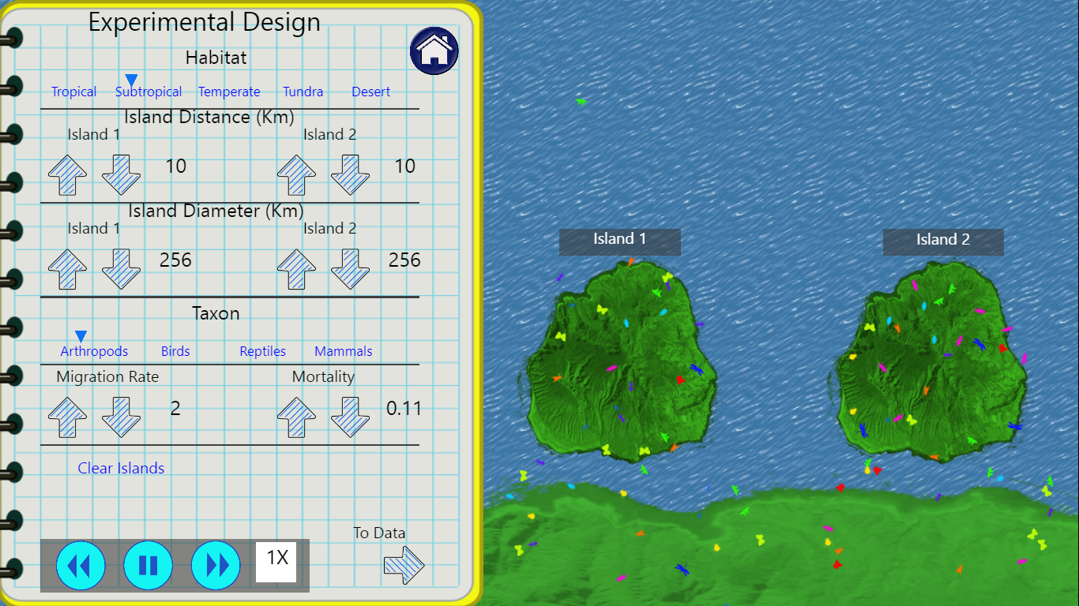
Settings for
Simulation #7

Slide 16
Question #7
Use the settings from the previous slide.
Click on the “data” arrow.
Run the simulation for 300 seconds
Answer the questions:
After 300 seconds, what is the average number of species for each island?
Explain the differences in averages between the islands in simulation #5 and simulation #7.

